Slide 1

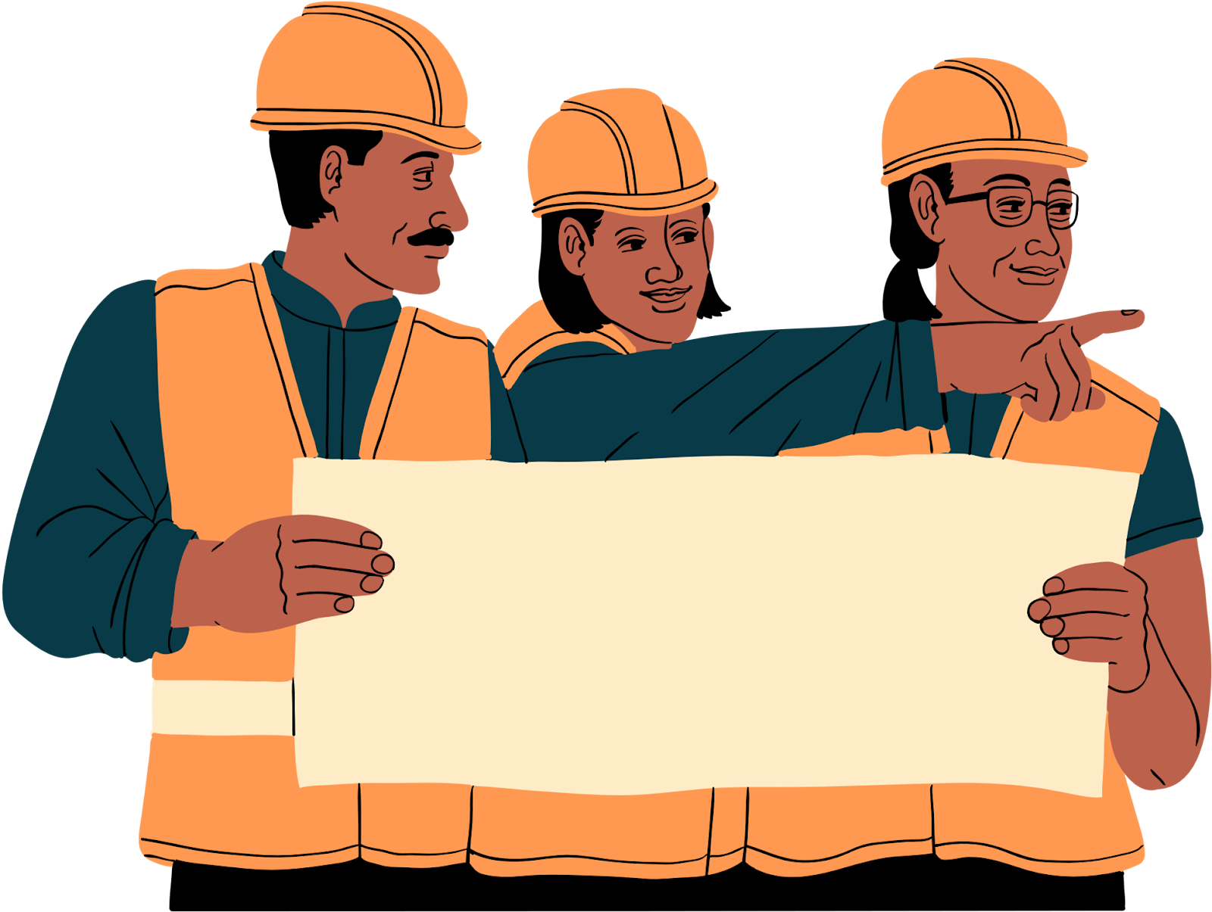
Comp Sci & Civil Engineering
A PRESENTATION BY IAT SENG, JOHN & VICTOR

Slide 2


Table Of Contents
1
Computer Science
What is Computer Science?
2
Civil Engineering
What is Civil Engineering?
3
The Relationship
How does CS relate to CE?
Notes:
2,3- john
1, Victor

Slide 3
Table Of Contents
4
Without CS
What would CE look like without CS?
5
With Better CS
What would CE look like with advanced CS?
6
The Task
Building a blueprint
Notes:
4 is victor
5 is iat seng
6 iat
Intro is iat seng

Slide 4


What Is Computer Science?
The study of computer and their systems:
Software and software systems
Theory
Design
Development
Application
Problems range from abstract to simple ones
Determining what problems are able to be solved
Designing simple applications
Notes:
TOC #1 Victor

Slide 5
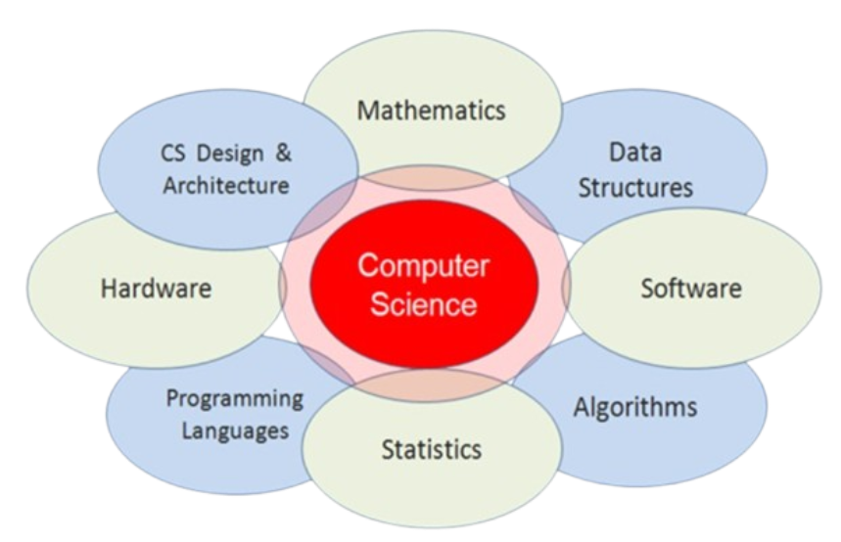
What Is Computer Science?
Includes but not limited to:
Programming
AI & ML
Cybersecurity
Computational Theory
Computer Hardware & Software
Databases
Networking
Solves problems
Focuses on improving automation and efficiency
[4], [5], [6]
Notes:
TOC #1

Slide 6



What is
Civil Engineering?
Civil Engineering is about designing and maintaining structures
From the construction to maintenance of the structures, Civil Engineers do all these things
They take in and account for the problems they could face and fix them
[1]
Eco Friendly projects
(Buildings that using less Co2)
Buildings
(Skyscrapers)
Geotechnical problems
(Buildings that resist Natural Disasters)
Notes:
John

Slide 7
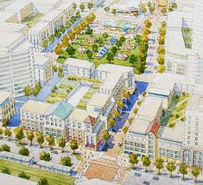
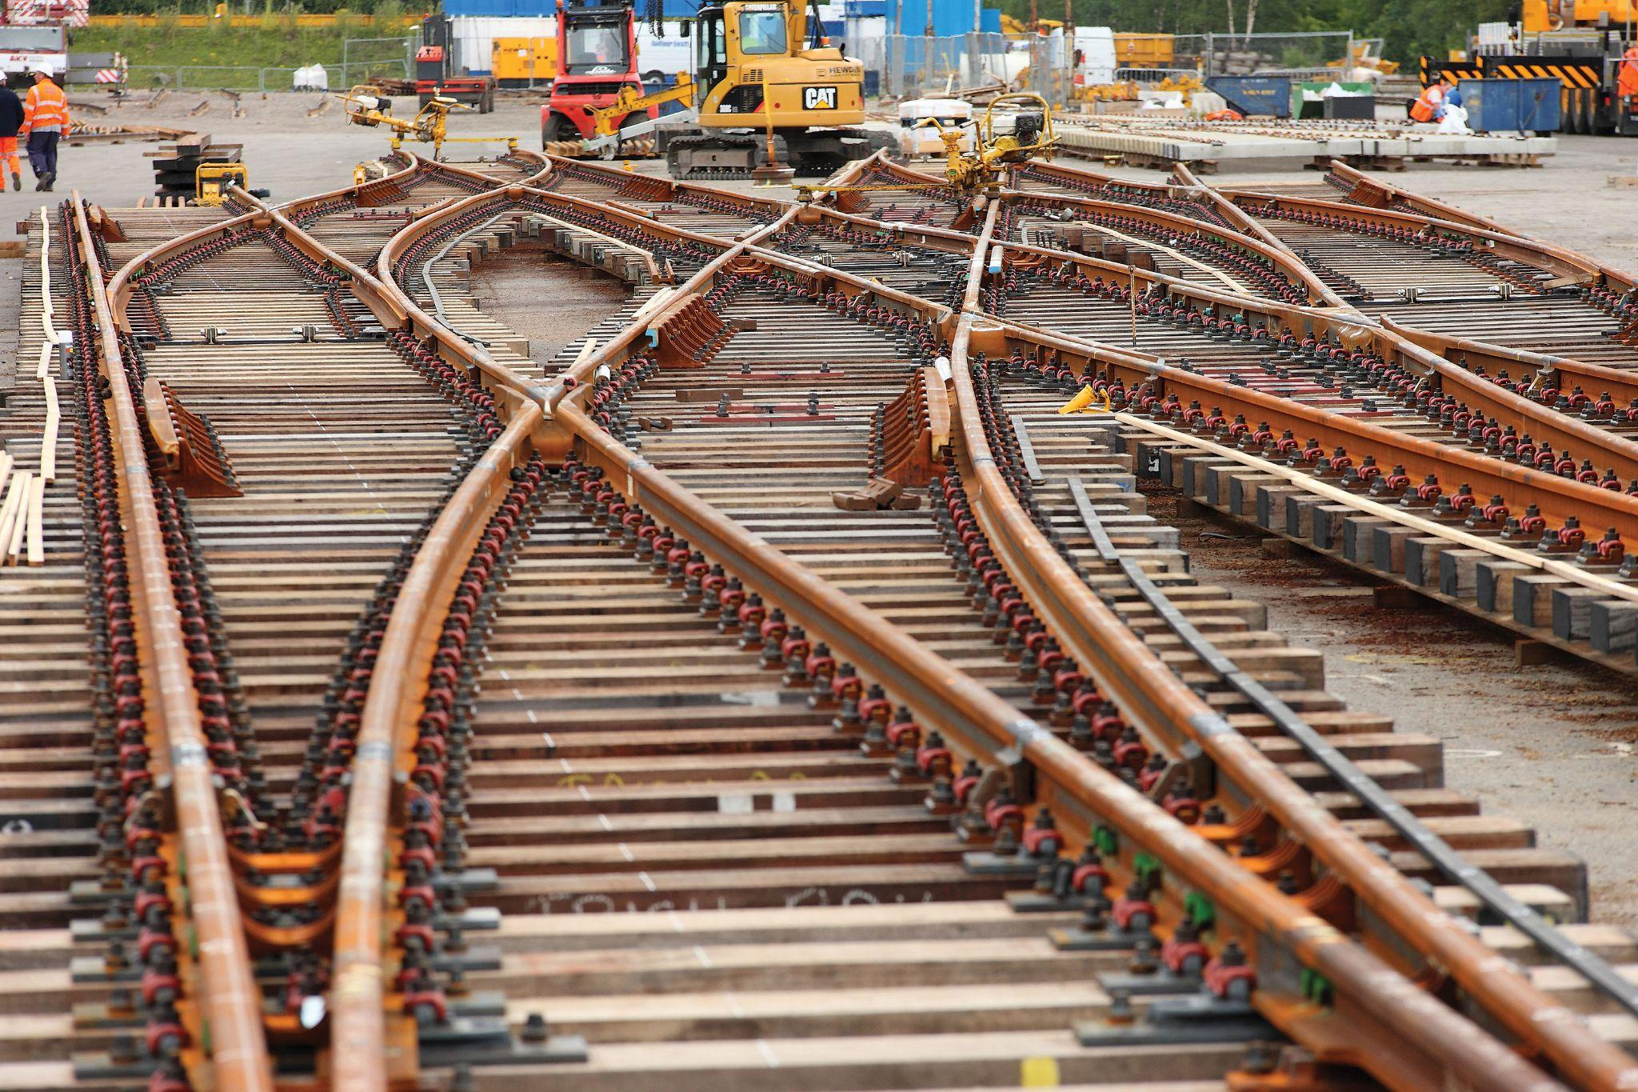

More examples
Transportation
Urban planning
(Planning and building cities)
Access to Water
(Pipes/Flow of water)
[1]
[1]
[1]
Notes:
John

Slide 8

How does CS relate to Engineering?
Timeline
Notes:
John

Slide 9
How does CS relate to Engineering?
Timeline
First used to efficiently design the cut and fill system
Helped save time
Civil engineering firms bought computer systems
CEPA, ASCE
[8]
1950s and 1960s
Notes:
John

Slide 10
How does CS relate to Engineering?
Timeline
Civil Engineering uses comp sci as a tool to help to them finish their calculations
Computer Science can help speed up the designing process and help civil engineers have more accurate and precise measurements
Civil engineers use programs to help simulate what their buildings would look like in real life.
[6]
[8]
Now
Notes:
John

Slide 11
How does CS relate to Engineering?
Timeline
Due to the increase in smart buildings, cities and simulation practices, CS will probably be part of the Civil Engineering job instead of a tool
Future
Notes:
John

Slide 12

Civil Engr. Without CS
Civil Engineering heavily depends on Computer Science
Without it, the environment would:
Struggle with tasks that algorithms could have provided
Longer time for basic tasks
Overall longer times
Economic losses due to time loss
Loss of jobs
Measurements would be inaccurate
[8]
Notes:
TOC #5 Victor

Slide 13

Civil Engr. With Better CS
More efficient/automation
Better tools
Robots
3D Printing
Better designing process
VR/AR
Simulations/AI
Improved resource/energy usage
Self maintaining Smart Buildings
Notes:
TOC #5 iat seng

Slide 14
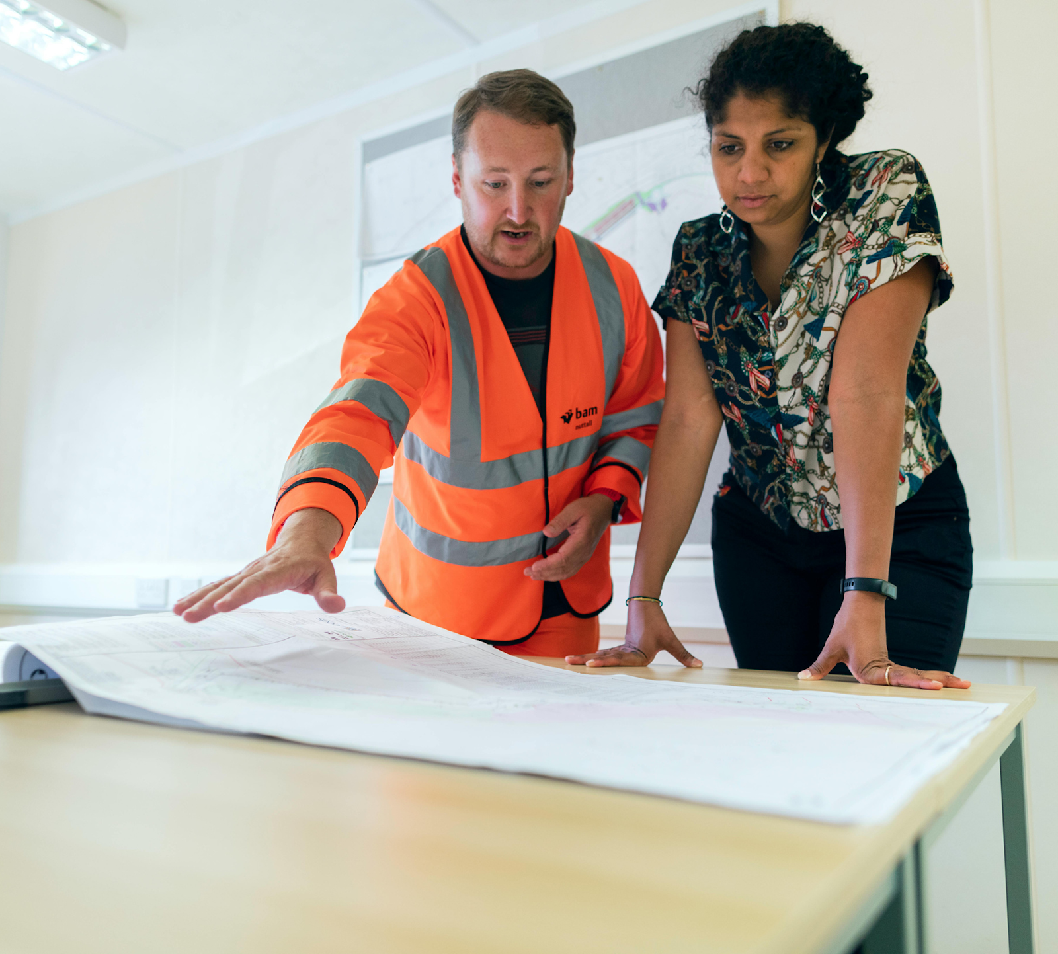


https://www.
planyourroom.
com/
[7]
Notes:
Activity iat seng

